Slide 1


Welcome to New Hire Orientation
Overview of Employee Benefits

Slide 2
MEDICAL – BLUECROSS BLUESHIELD
 | Plan A | Plan B | Plan C | Plan F
Networks | Preferred | Preferred & Choice | Preferred | Choice
General Plan Information |  |  |  | HSA Eligible Embedded Deductible
Calendar Year Deductible (CYD) | $750 Ind / $2250 Family | $1250 Ind / $3750 Family | $1500 Ind / $4000 Family | $3000 Ind / $6000 Family
Calendar Year Out of Pocket Max Includes deductibles and pharmacy/medical copays | $3000 Ind / $9000 Family | $3500 Ind / $10500 Family BP $4000 Ind / $12000 Family BC | $4000 Ind / $12000 Family | $6650 Ind / $13000 Family
Member Coinsurance | 20% after CYD | 20% after CYD BP 30% after CYD BC | 20% after CYD | 20% after CYD
Primary Office Visit Copay Specialty Office Visit Copay | $20 Copay $40 Copay | $25 BP / $35 BC Copay $40 BP / $50 BC Copay | $35 Copay $50 Copay | 20% after CYD
Preventive Care Visits (Well Baby, Adult/Child Immunizations, Routine Health Screenings) | No Charge | No Charge | No Charge | No Charge
Diagnostics Lab & X-Ray | 20% after CYD | 20% after CYD BP 30% after CYD BC | 20% after CYD | 20% after CYD
In-Patient Hospitalization & Out-Patient Surgery | 20% after CYD | 20% after CYD BP 30% after CYD BC | 20% after CYD | 20% after CYD
Allergy Treatment/Testing | 20% after CYD | 20% after CYD BP 30% after CYD BC | 20% after CYD | 20% after CYD
Emergency Room Urgent Care | $100 Copay, then 20% after CYD (waived if admitted) $40 Copay | $150 Copay, then 20%/30% after CYD (waived if admitted) $40 BP / $50 BC Copay | $150 Copay, then 20% after CYD (waived if admitted) $50 Copay | 20% after CYD
Health Risk Assessment | HA $250 deductible credit applies to 2021 plan year and must be completed between 1/1/2021 and 12/31/2021. HA must be completed and credited prior to claims payment. No retroactive claim adjustments will be allowed. |  |  | HA $200 deductible credit. Same rules as Plans A, B & C.
Mental Health Substance Abuse
In-Patient | 20% after CYD | 20% after CYD BP 30% after CYD BC | 20% after CYD | 20% after CYD
Out-Patient | $20 Office Visit Copay 20% after CYD for other services | $25 BP / $35 BC Copay 20% / 30% after CYD for other services | $35 Office Visit Copay 20% after CYD for other services | 20% after CYD

Slide 3
MEDICAL – BLUECROSS BLUESHIELD
 | Plan A | Plan B | Plan C | Plan F
Networks | Preferred | Preferred & Choice | Preferred | Choice
Rehabilitation Services: Outpatient: Separate 60 visit limits per benefit period for speech and occupational therapies. | 20% after CYD | 20% BP / 30% BC after CYD | 20% after CYD | 20% after CYD
Habilitation Services: Inpatient: 30 day limit per benefit period. PA required. | 20% after CYD | 20% BP / 30% BC after CYD | 20% after CYD | 20% after CYD
Physical and Chiropractic Therapy (combined limited to 60 visits per CY) | 20% after CYD | 20% BP / 30% BC after CYD | 20% after CYD | 20% after CYD
Durable Medical Equipment (DME) | 20% after CYD | 20% BP / 30% BC after CYD | 20% after CYD | 20% after CYD
Skilled Nursing Facility (100 days per CY) | 20% after CYD | 20% BP / 30% BC after CYD | 20% after CYD | 20% after CYD
Home Health Care (100 days per CY) | 20% after CYD | 20% BP / 30% BC after CYD | 20% after CYD | 20% after CYD
Hospice (PA Required) | 20% after CYD | 20% BP / 30% BC after CYD | 20% after CYD | 20% after CYD
Pharmacy
Generic Drugs | Retail: 25% of allowed amount; $25 Min / $50 Max Mail Order: 25% of allowed amount; $75 Min / $150 Max |  |  | 20% after CYD
Preferred Brand Name Drugs | Retail: 25% of allowed amount; $25 Min / $50 Max Mail Order: 25% of allowed amount; $75 Min / $150 Max |  |  | 20% after CYD
Non-Preferred Brand Name Drugs | Retail: 50% of allowed amount; $50 Min / $100 Max Mail Order: 50% of allowed amount; $150 Min / $300 Max |  |  | 20% after CYD
Specialty Drugs | 50% of allowed amount; $50 Min / $100 Max (Limited to 30 day supply) Must be ordered through Prime Therapeutics (no mail order available) |  |  | 20% after CYD
Supply Limits | 30 Day Supply Limit Retail. Up to 90 Day Supply of Maintenance Drugs. Up to 90 Day Supply Mail Order, In-Network Only

Slide 4

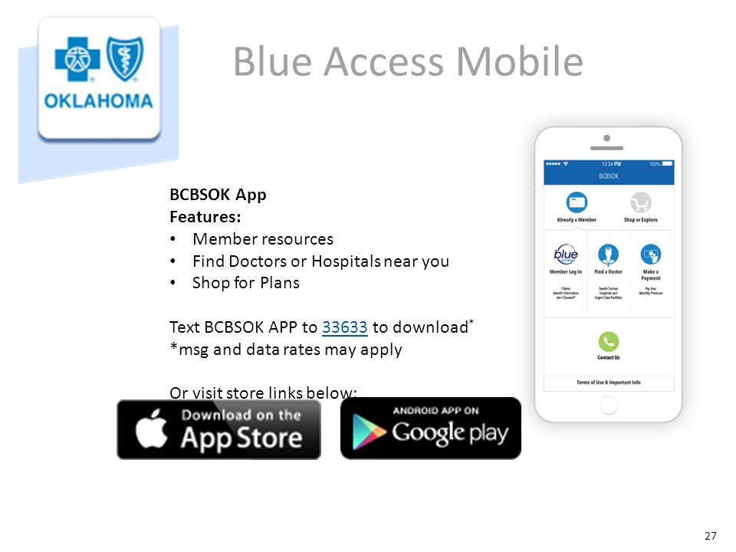

MEDICAL –
BLUECROSS BLUESHIELD
MUST KNOW:
  NSU will pay the following based on the plan design you choose
    Plan A, B, C & F: Employee Only Coverage is $0
    As you go through your online enrollment process, you’ll see how much it will cost to add dependents
Don’t forget about the BCBS Mobile App. Use when traveling out of town to find in-network providers. It also provides a virtual ID card in case you don’t have yours available.
Savings Tip!
Plan A and C will offer best discounts due to Preferred Network. Plan F allows you to set aside pre-tax money into a Health Savings Account that is yours to keep forever!

Slide 5
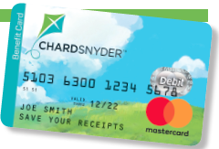
HSA, FSA & Limited FSA
IRS allows you to pre-tax payroll deductions into both accounts.
Cannot be enrolled in a FSA and HSA at same time.
HSA:
2021 IRS Contributions
    Employee Only - $3600
    Employee + One - $7200
    (Add’l $1000 from age 55-65)
Funds Rollover Year after Year (cannot contribute after age 65)
Can Invest Once Balance Reaches $2000
Interest Bearing from day one (0.0% to 1.00%)
If enrolled in Medicare, Indian Health Services or Military Coverage, ineligible for HSA
Must Enroll in the BCBS Plan F to Open an HSA
FSA: (paired with non-HSA health plans)
  2021 IRS Contributions
      Health Spending Account - $2750
      Dependent Care Account - $5000
  $550 Carryover Provision
  Use It or Lose It Rule Applies
Limited Health FSA: (paired with HDHP plans for dental and vision)
  2021 IRS Contributions
      Health Spending Account - $2750
      Dependent Care Account - $5000
  $550 Carryover Provision
  Use It or Lose It Rule Applies
Savings Tip!
No Use It or Lose It! Account can grow larger from year to year.
Savings Tip!
Budget carefully because at the end of the year, you could lose money over $550 if not claimed.

Slide 6
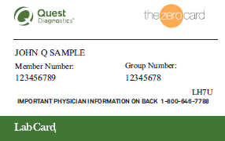

New Name -ZERO
MUST KNOW:
  Employees and dependents enrolled in the BCBS medical plans may use ZeroCard services free of charges
  This is a great way to lower out of pocket medical expenses such as imaging, surgeries, physical therapy and prescription costs for you and your covered dependents
  This program contains a special group of contracted providers
  To find providers, go to www.zero.health.com. Many providers are in both ZeroCard and BCBS Networks
  Go to any DLO Lab and present your LabCard and pay $0 for your lab work!
  If you enroll in the BCBS HDHP plan F, you cannot use the ZeroCard until after you have met your $3,000 Deductible.
Savings Tip!
Do you need labwork, physical therapy, surgeries or imaging? Remember these services are free when you use a ZeroCard provider.
Questions: Call 855-816-0001
Email: help@zero.health

Slide 7

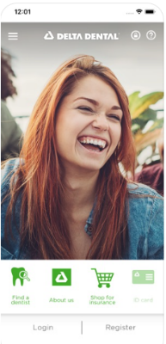
DENTAL – DELTA DENTAL
Employee pays full cost of dental plan.
Services | Delta High |  |  | Delta Low |  |  | Delta Preventive
Network | PPO | Premier | OON | PPO | Premier | OON | PPO
Preventive/Diagnostic | 100% | 100% | 100% | 100% | 100% | 100% | 100%*
Basic Restorative (Endodonics, Periodontic & Oral Surgery) | 85%* | 70%* | 70%* | 75%* | 70%* | 70%* | 80%*
Major Restorative | 60%* | 50%* | 50%* | 60%* | 50%* | 50%* | N/A
Orthodontic | 50% (Child Only to age 26) |  |  | N/A |  |  | N/A
Per Person Per Calendar Year Deductible | (was $50/$150) |  |  | (was $100/$200) |  |  | $50/$100
Annual Benefit Maximum | $2000 Per Person |  |  | $1000 Per Person |  |  | $750 Per Person
Orthodontic Benefit Maximum | Unlimited per Child |  |  | N/A |  |  | N/A
*After Deductible
 | Delta High | Delta Low | Delta Preventive
Employee Only | $39.82 | $29.96 | $18.26
Employee + Children | $75.82 | $53.80 | $39.58
Employee + Child | $58.64 | $44.06 | $30.24
Employee + Spouse | $79.60 | $64.28 | $37.52
Employee + Family | $119.56 | $90.10 | $60.18
Savings Tip!
Your annual maximum will go farther with PPO dentists, because their contracts with Delta Dental are stronger than Premier dentists.

Slide 8

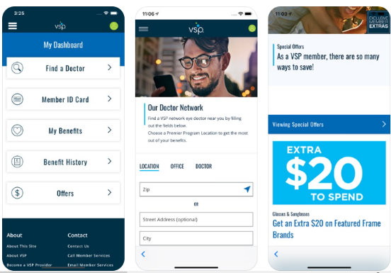
VISION – VSP
Must Know:
  No ID Card Needed! Just Provide Your Name and SSN To The Provider
  NSU pays for the Employee Only Base Plan
Plan: Base Option and Enhanced Option
  $10 Exams, $25 Materials (Lenses or Contacts), Frames ($150-$170 Allowable)
  Your Provider Network is “VSP Choice”
  Buy-up allows you to buy a second pair of glasses or contacts for a $25 copay
VSP Mobile App
 | Base | Buy-up
Employee | $0.00 | $5.75
Employee + Children | $7.46 | $19.79
Employee + Child | $6.28 | $17.55
Employee + Spouse | $6.56 | $18.09
Employee + Family | $15.82 | $35.50
Savings Tip!
Visit vsp.com for Coupons to use on brand name frames, discounts on laser vision correction, and additional savings for many vision products.

Slide 10

BASIC LIFE INSURANCE –
THE STANDARD
Must Know:
  Be Prepared To Provide Beneficiary Information
  It is best to list the individual’s that you wish to receive this benefit instead of All Living Children, Estate or Succession of Heirs
  NSU Pays 100% of Your Basic Life Group Benefit
Plans: Life and AD&D
  Your Life and AD&D Benefit is 2x Times Your Basic Annual Earnings Up to $250,000
Savings Tip!
Save your loved ones a hassle and share your benefit materials along with who to call in the event of your death. Peace of mind is valuable.

Slide 11
VOLUNTARY LIFE INSURANCE –
THE STANDARD
Must Know:
  Evidence Of Insurability (EOI) Is Required for any amount over Guarantee Issue Amount
  Be Prepared To Enter Beneficiary Information (name, address, date of birth, social security)
  Voluntary Life Insurance Is Paid By Employee
Plans: Voluntary Life and AD&D
  Benefits Are Available for:
    Employees - $10,000 - $500,000 ($300,000 Guarantee Issue*)
    Spouse - $5,000 - $250,000 ($50,000 Guarantee Issue*)
    Children - $2,500 - $10,000 ($10,000 Guarantee Issue) (No EOI required for children)
During Open Enrollment each year, all members, enrolled or eligible, may increase their benefit amount by up to $20,000, not to exceed the guarantee issue amount.
*Guarantee Issue for New Hires Only
Savings Tip!
Did you know that life insurance rates are less expensive when purchased through an employer plan? Take advantage of free resources such as Travel Assist and Life Services Toolkit.

Slide 12
SHORT TERM DISABILITY –
THE STANDARD
  Must Know:
  Voluntary Benefit Paid by Employee
  Bridge the gap to your Long Term Disability
  Your Benefit = 60% of Pre-disability Earnings up to $2,000/week (Min. $15)
  Before these benefits pay, you may choose to use your sick pay or any personal leave first
  Benefit: 14 Day Elimination with 76 days of coverage
  If you do not choose to enroll in the Short Term Disability at new hire and decide to enroll for next year, you will be subject to a 60-day benefit waiting period for sickness and pregnancy during your first 12 months in the plan.
Savings Tip!
Disability insurance protects your income if you are unable to work for a period of time due to a disability.

Slide 13
LONG TERM DISABILITY –
THE STANDARD
Must Know:
  Coverage to Normal Retirement Age
  Your Benefit = 60% of Pre-disability Earnings up to $8,000/month
  NSU Pays for the Buy-Up Plan for all employees
  If you decide to move to the buy-up plan during open enrollment, you must complete an Evidence of Insurability Form and will either be approved or declined.
Savings Tip!
Disability insurance protects your income if you are unable to work for a period of time due to a disability.

Slide 14
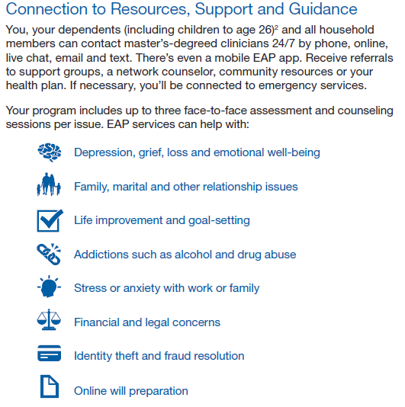
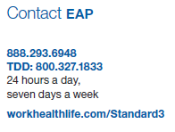

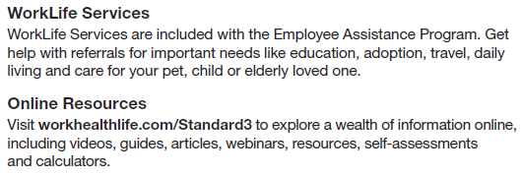
EMPLOYEE ASSISTANCE PROGRAM – THE STANDARD

Slide 15
VOLUNTARY BENEFITS – METLIFE & AMERICAN FIDELITY
Must Know:
  These are group plans and have low rates with good benefits.
  Payroll deductions will be after tax.
  MetLife is offering Guarantee Issue for all plans every year.
  $100 Annual Health Screening Benefit - go to www.metlife.com/mybenefits
MetLife Plans Offered:
  Accident – Variable pay based on service – Choice of Low and High Plan
  Critical Illness - $15,000 or $30,000 Benefit (Spouse gets 100% of the benefit)
  Hospital Indemnity - $100 or $200 per day benefit (10 days)
American Fidelity
  You can keep your American Fidelity products through a payroll deduction. You will not find American Fidelity products on the TBX online enrollment system. Call your American Fidelity enrollment representative for pricing and enrollment options at 888-531-0015.
Go to your online TBX portal to download plan summaries for additional information (i.e. qualified health screening tests and more).
Savings Tip!
Consider these plans to help with unexpected out-of-pocket costs. They pay you cash that can be used for deductible, coinsurance or personal expenses at those times.

Slide 16
IMPORTANT REMINDERS
You will only receive a BlueCross BlueShield Medical ID Card!
Benefits are effective the first of the following month.
There must be a “Qualified Life Event” to change your benefit elections outside of Open Enrollment
  If you have a Qualified Event, you must contact your Human Resource Department and they will create a event in the enrollment system to allow you to make changes. You must do this within 31 days of the event or you must wait until the next open enrollment to make changes
  These include Marriage, Divorce, Birth of a Child, Adoption, Death, Certain Changes in Job Status (part-time to full-time), or Gain or Loss of other Coverage
Savings Tip!
Evaluate your family situation and total plan costs across all benefits, rather than just keep what you’ve had in the past. Check Rx’s for generic alternatives!

Slide 17
TBX ONLINE ENROLLMENT PORTAL
QUICK REFERENCE GUIDE FOR ONLINE ENROLLMENT
To enroll go to https://my.tbx360.com/okheei
LOGIN INFORMATION
User ID: Banner ID or Social Security Number with no dashes
Personal ID: Last 4 of your Social Security Number and the last 2 digits of your birth year. Example xxx-xx-1234 and 1985, your PIN would be 123485
PERSONAL INFORMATION
No changes can be made on this screen. If you need to make changes to demographic information, send an email to Humanresources@nsuok.edu.
DEPENDENTS
This is the screen to add your dependents for Health, Dental and Vision and additional products. Please note dependents can be different from beneficiaries. A Dependent Verification may be required to upload.
BENEFITS GURU
The Benefits Guru is informational to assist in choosing the correct plan for your needs. If you know the plan you want to elect, then go to the bottom left and click on “Skip Benefits Guru” and Continue.

Slide 18
Quick Reference Guide continued.
MY BENEFITS
This is a list of Your Available Plans that you will go through during your enrollment. You can keep track of where you are and that is left to complete. You can leave and come back.
HEALTH-BlueCross BlueShield (BCBS)
Choose your Plan; Plan A, B, C, or F*. Remember* Plan F is a Health Savings Account Plan (HSA). Click on who will be covered. Example; Employee Only or Employee+Child and then click Enroll. If you do not want a particular coverage, click on Decline.
ACCIDENT INSURANCE, CRITICAL ILLNESS, HOSPITAL INDEMNITY- OPTIONAL MetLife Policies
Please note all of these policies are Post-Tax deductions. You will need beneficiary information on some of the policies.
**PLEASE NOTE** AMERICAN FIDELITY policies are not on your on-line enrollment. Call American Fidelity Enrollment for pricing and enrollment options at 888-531-0015.
DENTAL-Delta Dental
Select your option, who you will cover and click Enroll.
***Please BEWARE to enroll in the correct plan as they are listed as Preventive, Low, High***
VISION-Vision Service Plan (VSP)
Remember the Base Plan is at no cost and the Vision Enhanced Plan is a premium you would pay.
Click on the plan and whom you wish to cover then click Enroll.

Slide 19
Quick Reference Guide continued.
EMPLOYER FUNDED LONG TERM DISABILITY - TheStandard
No decisions to make as this is provided by the University. Click Next
BASIC LIFE AND AD&D-TheStandard
No decisions to make as this is provided by the University. Click Next.
Choose Beneficiaries
  Information you will need for beneficiaries; YOU MUST HAVE THIS INFORMATION
  Name, Date of Birth, Social Security number, Address, Phone
  To add a Beneficiary go to the far right in the gray bar and click on the + to add or the Pencil to edit information. You must click on Primary and then click Next.
SPOUSE LIFE AND AD&D
Slide the bar to the requested amount. click “wish to apply” or “decline” coverage then click Next.
ADDITIONAL LIFE AND AD&D
This is life insurance in addition to what the University pays. If you stay within the amount in the green bar, it is a guaranteed issue. If you go into an amount in the pink bar, an Evidence of Insurability would need to be completed for approval. Choose Beneficiary, click Next.

Slide 20
Quick Reference Guide continued.
HEALTHCARE FLEXIBLE SPENDING ACCOUNT (FSA)-CHARD SNYDER
If you wish to elect-either put in the amount per pay period OR Total amount and click on Calculate.
Click “wish to apply” or “decline” coverage then click Next.
NOTE** you will be receiving a Reimbursement card from Chard-Snyder so watch your mail.
DEPENDENT CARE FSA-CHARD-SNYDER
Choose to elect or decline then click Next.
SIGN AND SUBMIT
YOUR BENEFITS-Look over this carefully. If you need to make changes-click on the plan on the left and it will take you back and you will click Unlock and then change your election and Next again and you will be directed back to YOUR BENEFITS. If you are ready to submit click Next.
REVIEW/SIGN FORMS
This is your summary. If correct, you can Download Form on far right to keep for your records.
You are then ready to click Sign Form, which is your electronic signature.
Please Note**** you DO NOT need to sign and send to HR.
REQUIRED NOTIFICATION
You may or may not have any notifications. click Sign Form
SIGN/SUBMIT COMPLETE
Congratulations!!! Your enrollment is complete. You can now logout. Remember this is your enrollment sight to reference throughout the year.

Slide 21
RETIREMENT ACCOUNTS
Oklahoma Teachers Retirement System is required for Exempt employees, it is optional for Non-Exempt employees. Members are required to contribute 7% of the first $25,000 of annual salary plus benefits each fiscal year. The University contributes 7% of salary and benefits over $25,000. Maximum contribution for employee will be $145.83 per month for Exempt or $67.31 for Non-Exempt each Bi-weekly paycheck for a total of $1750 each year (July – June). The number of years to “vest” and become eligible for a TRS pension is 7 years effective 11/1/17. Benefit amounts are calculated on a combination of average salary and years of service. There is also an $18.000 Death benefit as an active member. www.ok.gov/trs
The following 2 links are the required forms to complete
https://oklahoma.gov/content/dam/ok/en/trs/documents/form1a-personal-data-form.pdf
https://oklahoma.gov/content/dam/ok/en/trs/documents/form2a-designation-of-beneficiary-notretiredpoa.pdf
_{Decline form}
Optional 403(b) plan available through VOYA at www.OK2retire.com

Slide 22
Any Questions?
Thank you for participating today!

