Slide 1



Welcome to New Hire Orientation

Slide 2
RETIREMENT ACCOUNTS
Oklahoma Teachers Retirement System is required for Exempt employees, it is optional for Non-Exempt employees. Members are required to contribute 7% of the first $25,000 of annual salary plus benefits each fiscal year. The University contributes 7% of salary and benefits over $25,000. Maximum contribution for employee will be $145.83 per month for Exempt or $67.31 for Non-Exempt each Bi-weekly paycheck for a total of $1750 each year (July – June). The number of years to “vest” and become eligible for a TRS pension is 7 years effective 11/1/17. Benefit amounts are calculated on a combination of average salary and years of service. There is also an $18,000 Death benefit as an active member. www.ok.gov/trs
Optional 403(b) or 457 plans are available through VOYA at www.OK2retire.com

Slide 3
Medical & Prescription
Offered by
BlueCross BlueShield of Oklahoma

Slide 4
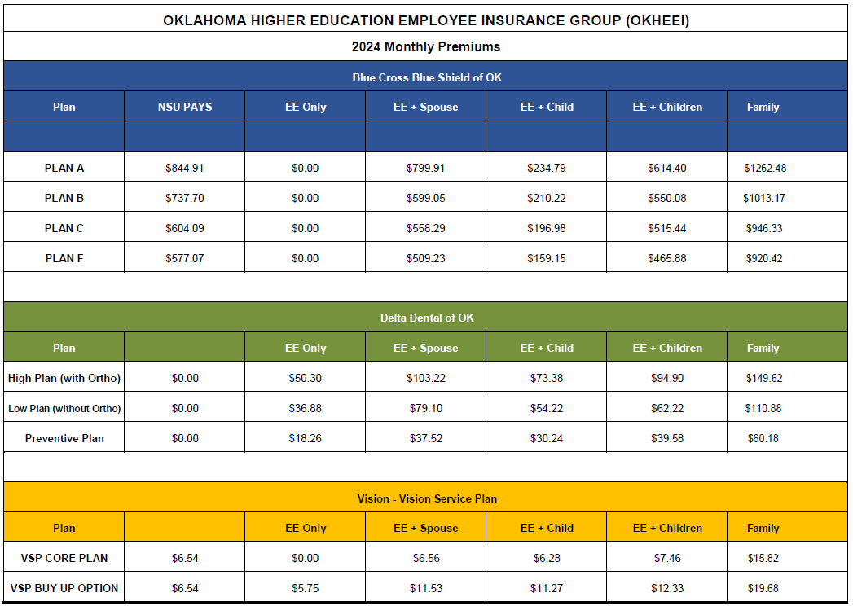

Slide 5
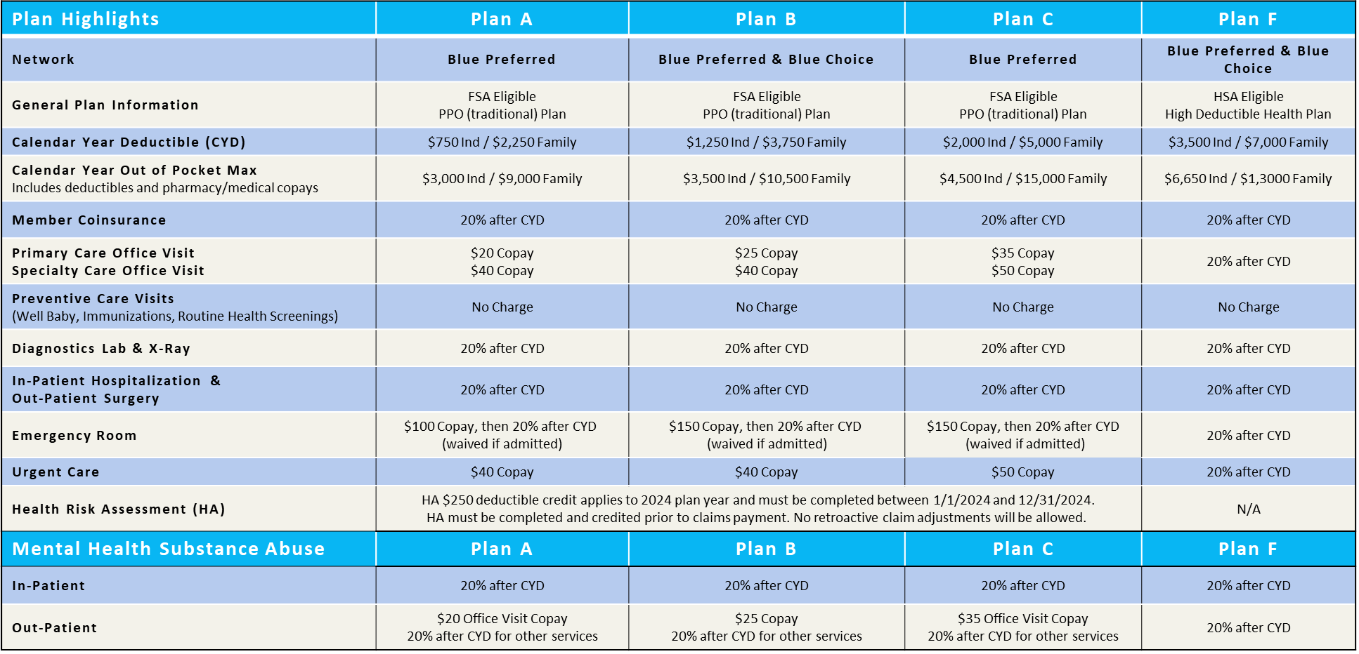
BlueCross BlueShield of Oklahoma

Slide 6
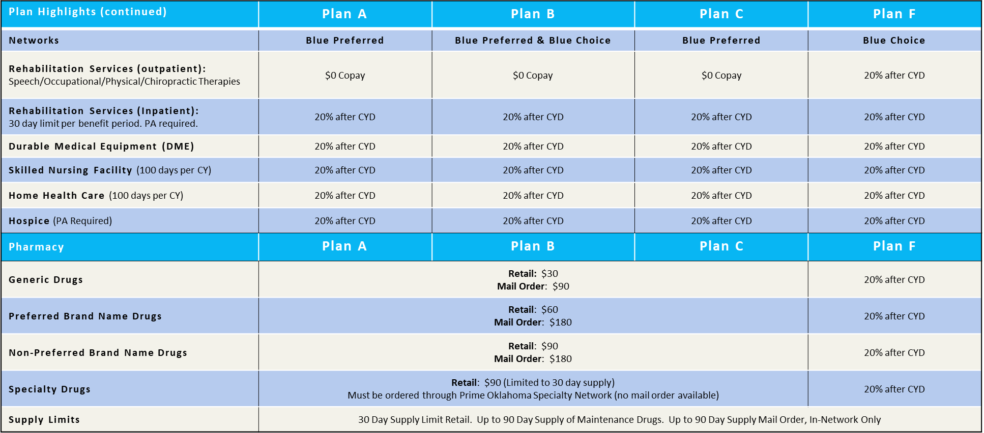
BlueCross BlueShield of Oklahoma
CYD = Calendar Year Deductible

Slide 7
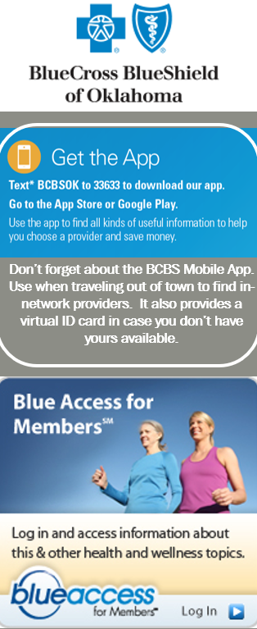

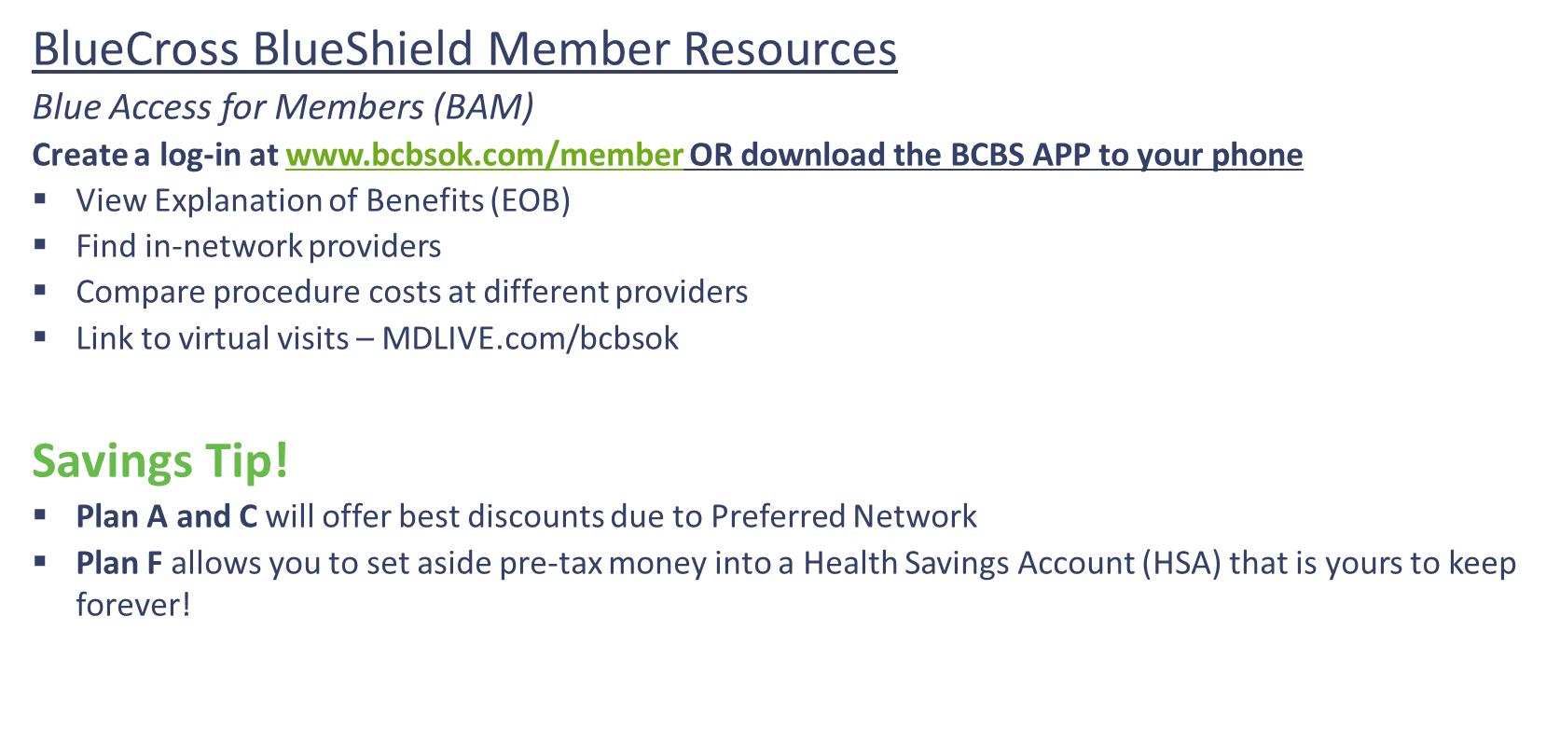


Slide 8






Wellness Programs

Slide 9

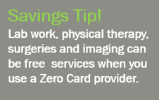
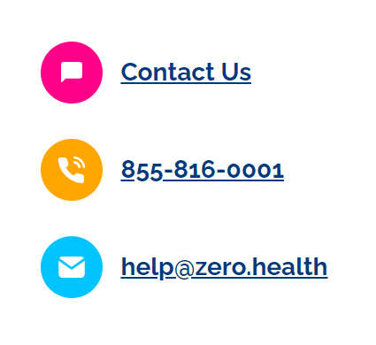
Employees and dependents enrolled in BCBS medical plans may use Zero services free of charge.
This is a great way to lower out of pocket medical and prescription costs for you and your family members.
$0 out-of-pocket for plan members. No copays. No deductibles. No coinsurance. It’s healthcare the way it should be.
This program contains a special group of contracted providers.
To find providers, go to www.zero.health. Many providers are in both Zero Card and BCBS Networks.
If you enroll in the BCBS HDHP (Plan F), you cannot use the ZeroCard until after you have met your $3,500 Deductible.

Slide 10

1. Check that your medication is covered at rxngo.com - search by therapeutic category or medication name
2. Create Profile or use Self-Service Portal at rxngo.com to sign up and manage prescriptions. You can also provide details to customer service at 888.697.9646
3. Any Questions? Email rxngo@transitionrx.com
OR
Mail your completed Patient Profile Form and original prescription(s) to Rx 'n Go at the following address:
Rx 'n Go c/o Transition Pharmacy
2546 Metropolitan Dr
Trevose, PA 19053
Have your physician E-Scribe, phone or fax your prescription(s) directly to Rx 'n Go:
• E-Scribe: Rx 'n Go fulfillment pharmacy, Transition Pharmacy PA NPI #: 1336325265
• Phone: 888.697.9646 (must come from your physician's office)
• Fax: 888.697.0646 (must come from your physician's office)
Note: Federal and state laws require the presence of the original prescription for pharmacies to fill any controlled substances and narcotic medications. E-Scribe or Mail original prescription to the address provided on this card. Adult Signature may be required.
Rx 'n Go Provides:
• $0 Copay, $0 Shipping Costs
• 90-day prescriptions (subject to state & federal regulations)
• Automatic refills for medication prescribed for over 90-days

Slide 11
IRS Money Accounts
Health Savings Account | Flexible Spending Accounts

Slide 12
HSA, FSA, Dependent Care & Limited FSA*
~IRS allows you to pre-tax payroll deductions into both accounts.
~Cannot be enrolled in an FSA and HSA at same time.
Health FSA (paired with Medical Plans A, B or C)
Limited FSA (dental and vision only)
Limited Purpose FSA (pared with HDHP/HSA)
2024 IRS Contributions Limits:
FSA $3,200
$640 Carryover Provision
Use it or lose it rule applies
Dependent Care FSA
$2,500 if married and filing separately
$5,000 if married and filing jointly
HSA (paired with HDHP)
2024 IRS Contribution Limits:
Employee Only - $4,150
Employee + One - $8,300
Age 55+ additional - $1,000
*Ineligible to make HSA contributions if enrolled in Medicare Part A, B, or D
Funds Rollover Year after year
Must maintain a minimum balance of $1,000 if you would like to invest the funds
Interest bearing from day one (0.0% to 1.00%)
May be ineligible for HSA Contributions if you do not meet other IRS requirements.
Must enroll in the BCBS Plan F to open an HSA

Slide 13
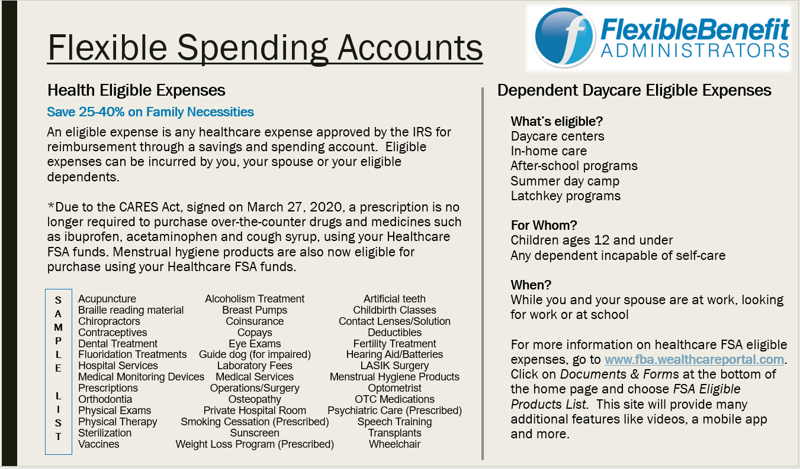

Slide 14
Ancillary Benefits
Dental | Vision | Life | Disability

Slide 15
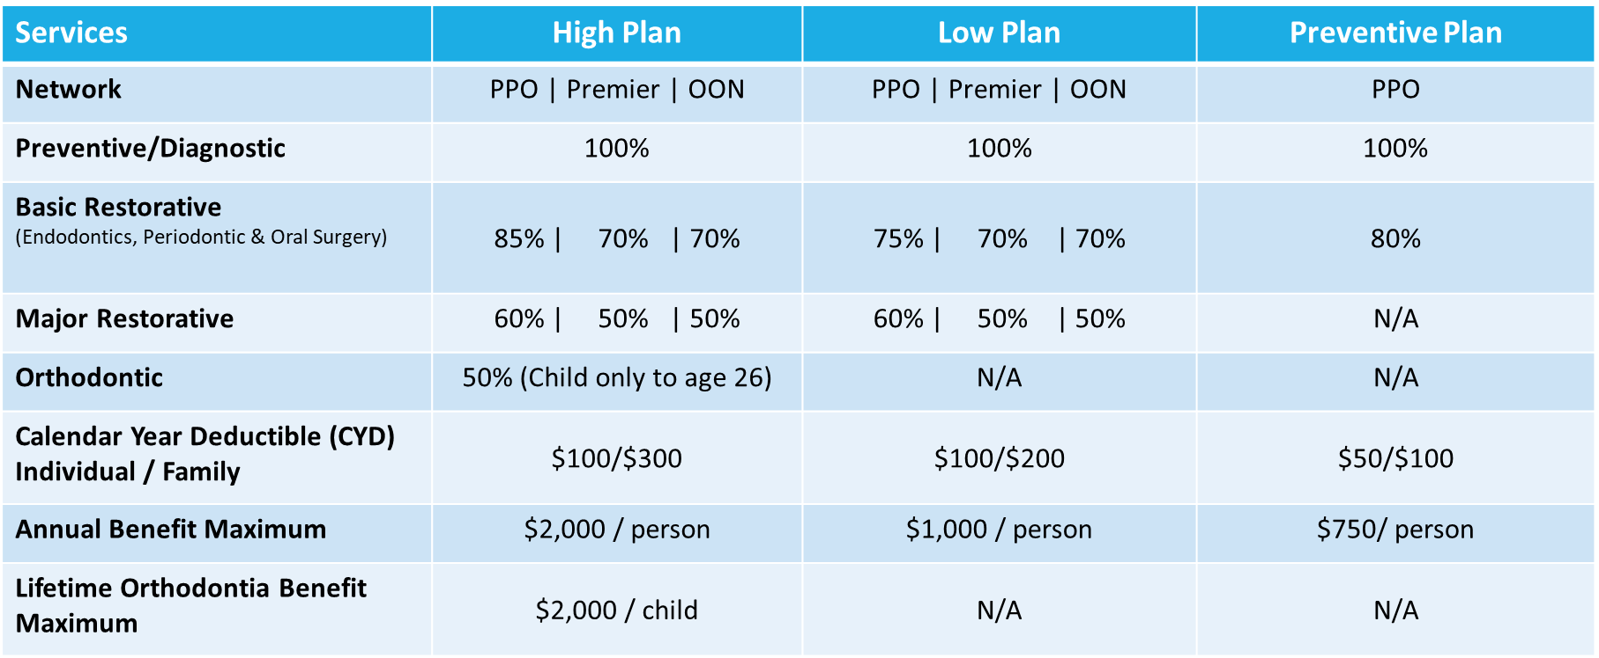
Dental – Delta Dental of Oklahoma

Slide 16
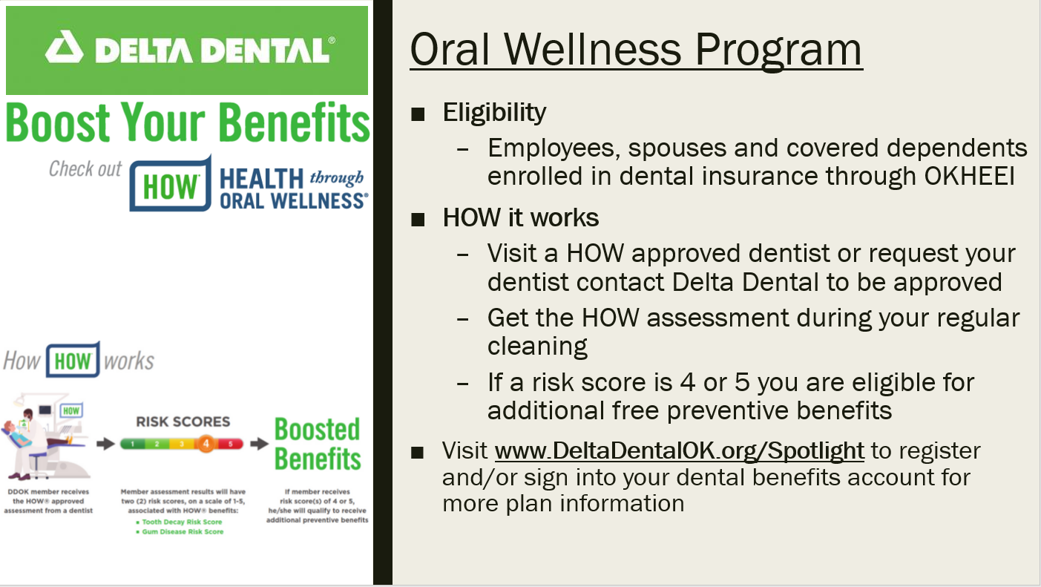

Slide 17

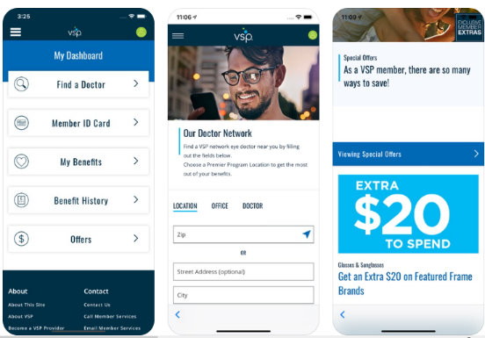

VISION – VSP
Must Know:
  No ID Card Needed! Just Provide Your Name and SSN To The Provider
  NSU pays for the Employee Only Base Plan
Plan: Base Option and Enhanced Option
  $10 Exams, $25 Materials (Lenses or Contacts), Frames ($150-$170 Allowable)
  Your Provider Network is “VSP Choice”
  Buy-up allows you to buy a second pair of glasses or contacts for a $25 copay
VSP Mobile App
 | Base | Buy-up
Employee | $0.00 | $5.75
Employee + Children | $7.46 | $19.79
Employee + Child | $6.28 | $17.55
Employee + Spouse | $6.56 | $18.09
Employee + Family | $15.82 | $35.50
Savings Tip!
Visit vsp.com for Coupons to use on brand name frames, discounts on laser vision correction, and additional savings for many vision products.

Slide 18
Basic Life and AD&D Insurance –The Standard
Basic Life and AD&D Benefit:
Employee Basic Life is 2x your base annual earnings up to $250,000
Accidental Death & Dismemberment (AD&D) pays your beneficiary 2x your basic life amount
Accelerated Death Benefit pays you 80% of life benefit if you are terminally ill and have 12 months left to live
Benefit Reduction at ages 65, 70, and 75
Must Know:
Beneficiary updates will be completed through Empyrean – be prepared to provide: name, address, date of birth & SSN of your beneficiaries
NSU pays 100% of your basic life benefit

Slide 19

VOLUNTARY LIFE INSURANCE – THE STANDARD
Must Know:
New Hires: Evidence Of Insurability (EOI) Is Required for any amount over Guarantee Issue Amount
Current Employees: EOI is required if coverage previously declined or if electing coverage above the Guaranteed Issue (GI) Amount.
Be prepared to enter beneficiary information (name, address, DOB, SSN)
Voluntary Benefit Paid by employee
Voluntary Life and AD&D Benefit:
Employee Life: $10,000 - $500,000 in $10K increments (GI: $300,000)
  If already enrolled, you can increase by a max of $20,000 ($10K increments) without submitting Evidence of Insurability (EOI)
Spouse Life: $5,000 - $250,000 in $5K increments (GI: $50,000)
  If already enrolled, you may increase coverage by a max of $10,000 ($5K increments) without submitting EOI
Child(ren) Life: $2,500 to $10,000 in $2,500 increments (No EOI required, GI: $10,000)
  *Guarantee Issue for New Hires Only
Savings Tip!
Did you know that life insurance rates are less expensive when purchased through an employer plan? Take advantage of free resources such as Travel Assist and Life Services Toolkit.

Slide 20
SHORT TERM DISABILITY – THE STANDARD
  Must Know:
  Voluntary Benefit Paid by Employee
  Your Benefit = 60% of Pre-disability Earnings up to $2,000/week (Min. $15)
  Before these benefits pay, you must use any available leave before accessing this benefit
  Benefit: 14 Day Elimination with 76 days of coverage
  Bridge the gap to your Long Term Disability
  If you do not choose to enroll in the Short Term Disability at new hire and decide to enroll for next year, you will be subject to a 60-day benefit waiting period for sickness and pregnancy during your first 12 months in the plan.
Savings Tip!
Disability insurance protects your income if you are unable to work for a period of time due to a disability.

Slide 21
LONG TERM DISABILITY –
THE STANDARD
Must Know:
  NSU Pays for the Buy-Up Plan for all employees which begins on the 90th day of illness or injury
  Your Benefit = 60% of Pre-disability Earnings up to $8,000/month
  Coverage will pay until you can return to work or to Normal Retirement Age
Savings Tip!
Disability insurance protects your income if you are unable to work for a period of time due to a disability.

Slide 22



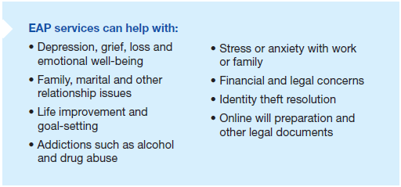
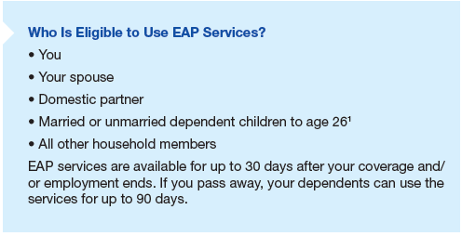
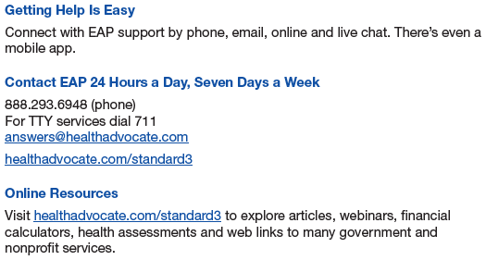
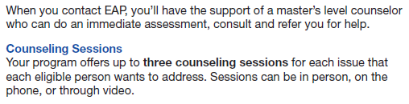

Slide 23

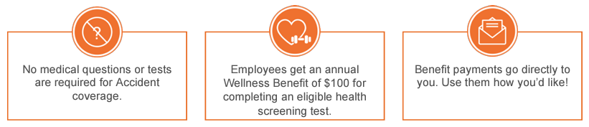

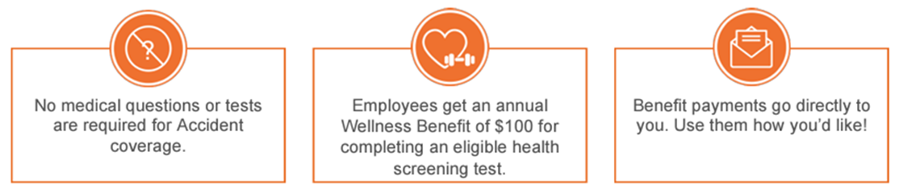

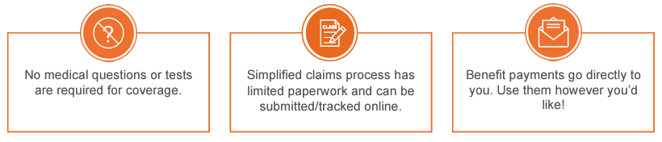
Voluntary Insurance
Voya.com/claims
Accident
Variable pay based on service
Low and High Plans available
Critical Illness
Choose between $15K and $30K benefit
Covered Spouses get 100% of Employee benefit
Hospital Indemnity
Initial Admission Benefit & Daily Benefit
Low and High Plans available
Savings Tip!
These plans can help with out-of-pocket medical costs. Pay outs can be used for deductible, coinsurance, or personal expenses like groceries.
These policy premiums are payroll deducted after tax
Benefit summaries and costs can be viewed through Empyrean
You may elect up to the Guarantee Issue amounts each year without EOI

Slide 24

American Fidelity – Voluntary Benefits
Plans Offered: Short Term Disability (STD), Accident, Cancer, Critical Illness, Hospital Gap, Life Insurance
Voluntary Benefits Paid by employee
If you currently have American Fidelity products through a payroll deduction, you can continue with no changes.
You will not find American Fidelity products on the Empyrean enrollment system. Call your American Fidelity enrollment representative for pricing and enrollment options at 888-531-0015.
You do not need to use your medical leave or any personal leave first before STD will pay.

Slide 25
IMPORTANT REMINDERS
You will only receive a BlueCross BlueShield Medical ID Card!
Benefits are effective the first of the following month you begin work.
There must be a “Qualified Life Event” to change your benefit elections outside of Open Enrollment
  If you have a Qualified Event, you must contact your Human Resource Department and they will create a event in the enrollment system to allow you to make changes. You must do this within 31 days of the event or you must wait until the next open enrollment to make changes
  These include Marriage, Divorce, Birth of a Child, Adoption, Death, Certain Changes in Job Status (part-time to full-time), or Gain or Loss of other Coverage.

Slide 26


Manage Benefits in Empyrean https://compass.empyreanbenefits.com/okheei
Verify your personal and dependent information is accurate
Review your plan options and make enrollment decisions
Need assistance? Call the OKHEEI Employee Benefits Center at 888-965-4334 (8am-5pm, M-F). We are a part of the OKHEEI Group, if they ask what school you are with.

Slide 27
To Do List
Complete Oklahoma Teachers Retirement Forms and return to Cammie at smith46@nsuok.edu
Enroll in the Empyrean online enrollment for benefits at https://compass.empyreanbenefits.com/okheei
Get your NSU ID(1st Floor UC) and Parking permit(Basement of UC)
Take the training for Title IX from 3E
Take the safety training and forward certificates to Dennis at safetyservices@nsuok.edu
Update the online directory
Take portrait for online directory in the Webb Building, 1st floor, room 114 with Abigail Kelley ext 2889. This truly takes a few seconds

Slide 28
Any Questions?
Thank you for participating today!

