Slide 1
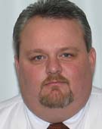
Safety Services
Dennis Moore
Coordinator of Safety Services

Slide 2
Our duties and responsibilities under O.S. Title 40 Section 403A.
Designate an employee (Dennis Moore) who shall coordinate all safety programs of the employer;
Provide safety classes to each type or class of employee no less than quarterly, except that public schools shall only be required to provide safety classes or instruction to their employees during the school year. Provided further, public school employees who are certified personnel and are in compliance with federal OSHA occupational safety and health standards shall be exempt from such safety classes or instruction and shall not be included in the computation of the number of employees set forth in subsection E of this section for determining the requirement of such safety classes or instruction; and
Cooperate with the Department of Labor including allowing any announced inspection of the premises for the purpose of determining compliance with this subsection.

Slide 3
CALM- College Association of Liability Management
CALM has partnered with Safety Source for our safety training provider
Log in to take your course
Courses are 5 to 15 minutes long
Print your certificate
Forward the certificate to Safety Services
Once you are logged in you can take any classes you like, free of charge.

Slide 4
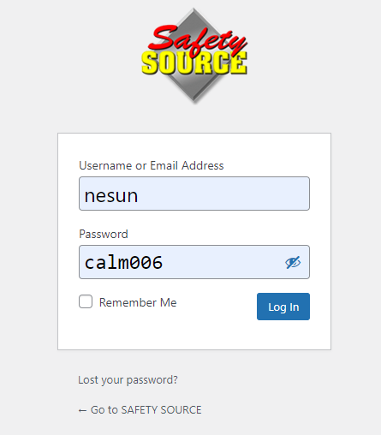
https://safetysourceonline.com/company/calm/

Slide 5
Documentation
After taking any course, you can print a certificate in the upper right corner:
Submit a copy to your supervisor, and send one to: SafetyServices@nsuok.edu

Slide 6
OSHA Course Requirements

Slide 7
Bloodborne Pathogens- Know the Risks

Slide 8
PPE: Basic Training

Slide 9
Hazard Communications- HAZCOM

Slide 10
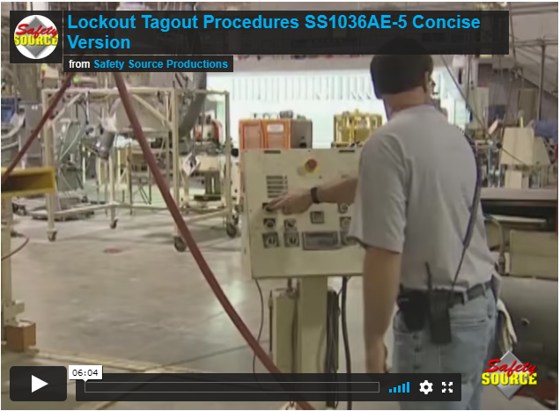
Lockout-Tagout

Slide 11
Questions?

